Slide 1
Ethics Protocol:
A method for designing responsibly
6.170 Fall 2020
Serena Booth
Content: Milo Phillips-Brown and Abby Jaques
Notes:
Introduce myself
Note my conflicts of interest:
Former Google Employee
Currently mostly funded by the NSF and MIT
Today I’m presenting the ethics protocol, a method for designing responsibly, which was created by Milo and Abby.
Milo introduce?

Slide 2
Responsibility
Notes:
Following Professor Jackson’s introduction to Dark Patterns, I’d like to talk about our responsibility as engineers. We’ll take a look at some case studies, and assess how we might respond.
Talking about ethics, especially without formal training, can be challenging. We want you to have psychological safety here, so we ask that everyone adhere to the rule: “what’s learned here leaves here, what’s said here stays here.” In particular, please do not repeat anything said by your classmates outside the classroom.
You of course will not be judged or evaluated based on your responses in class. Most of all, we want your participation!

Slide 3
Responsibility
Some Choices
Happy to do it
Reluctant but would do it
Object to doing it and ask for an alternative task, but would do it if I had to
Leak information to the public, but don’t resign from my job
Keep your job, but organize with others to stand up to leadership in the future.
Resign from my job rather than do it
Resign from my job and leak information to the public
You’re an engineer at change.org.
Your users have been learning that your company is for-profit, and that your petitions are never presented to government in an official capacity. They’re starting to leave your platform.
Your manager asks you to design an alternative change.org website to look and feel exactly like real government petitions using their newly purchased change.whitehouse.org domain.
What do you do?
Cite: Abeba Birhane
Notes:
OK, here’s our first case study.
You’re an engineer at change.org…. What do you do?

Slide 4
Responsibility
Some Choices
Happy to do it
Reluctant but would do it
Object to doing it and ask for an alternative task, but would do it if I had to
Leak information to the public, but don’t resign from my job
Keep your job, but organize with others to stand up to leadership in the future.
Resign from my job rather than do it
Resign from my job and leak information to the public
You’re a UROP. You’re interested in going to grad school, and you had a hard time getting this position. You’re hoping for a good letter.
Your grad student mentor works on a method for explaining the decisions of autonomous systems. Your grad student recently realized their system could also work for drones.
They task you with creating a website to help military personnel assess UAV decisions. They say, “they’re already using the drones, this will just increase accountability.”
What do you do?
Cite: Abeba Birhane

Slide 5

Ethics: why should I care?
Notes:
Maybe these ideas sound simple. They become more complicated when you add more constraints: family obligations, promotion cycles, paychecks.
Maybe ideas and predicaments sound farfetched, but the truth is that they are not.
If you’re in this class, you’re most likely a 3rd year or 4th year undergraduate. Through this class, you have now recreated the core functionality of a popular social media app. Take a second to think about that: you’ve been learning this subject for just a few years, and you have the skills to actually, really make something.
OK, it’s a prototype and it’s not ready to scale to hundreds of millions of users. But, if we sent you off into the world, bestowed with handy tools like Stackoverflow and Search, we know you could build real things to be used by real people.
And, I’m sure you’re aware that you’re in the same position now as Mark Zuckerberg was when he started Facebook. So, we want to remind you: With great power comes great responsibility.

Slide 6
Ethics: why should I care?
We claim: exploring ethics and assessing your values now will help you make better decisions in the future.
Now: less pressure, less stress, fewer sources of conflict.
The ethics protocol is a tool to help you with such decisions.
Notes:
Thinking about ethics now is important.
Maybe you don’t yet have the experience to assess your responsibility, and you don’t know how you’ll feel when your paycheck is on the line.
Still, thinking about building responsibly now when you have (believe it or not) less pressure, less stress, and fewer sources of internal conflict can help you make better decisions in the future.
To that end, today I’m going to introduce a tool called the “Ethics Protocol”, designed by Milo and Abby, to help us design responsibly.

Slide 7
Ethics: why should I care?
We claim: exploring ethics and assessing your values now will help you make better decisions in the future.
Now: less pressure, less stress, fewer sources of conflict.
The ethics protocol is a tool to help you with such decisions.
You will use the ethics protocol for your final projects.
Notes:
If all of that isn’t reason enough to care, I’ll give you one more. We will ask you to use the ethics protocol for your final projects.

Slide 8
Ethics Protocol Goals
Make more informed decisions
Justifying existing/past decisions
Notes:
So, what does the ethics protocol do and how does it work?
First off, the ethics protocol should be used throughout design to inform technical design decisions.
It should not be used after-the-fact, to justify existing decisions. That won’t help you design responsibly.

Slide 9
Ethics Protocol Goals
Make more informed decisions
Assess priorities, compromise
Justifying existing/past decisions
Search for a simple “right” answer
Notes:
While some decisions have clear “yes” or “no” answers, these are actually pretty rare. Normally there is a spectrum of possible outcomes, and you have to assess and balance these outcomes. The ethics protocol is a tool to help you assess your priorities, and to reach this compromise.
You may be disappointed to hear that there is no single best, right answer. There’s no way around that: your personal values are an integral part of this process.

Slide 10
Ethics Protocol Goals
Make more informed decisions
Assess priorities, compromise
Avoid thoughtless blunders
Justifying existing/past decisions
Search for a simple “right” answer
Replacing participatory design
Notes:
By considering the needs and experiences of our stakeholders, the ethics protocol can help us avoid thoughtless blunders.
However, without participatory design, we’re very vulnerable to blind spots. We likely do not understand the implications of our design decisions for all stakeholders. I want to stress: The ethics protocol cannot replace participatory design.

Slide 11
Ethics Protocol Overview
Envision Possible Futures
Notes:
A quick overview of the ethics protocol, before we dive into the details.
The first step is what we asked you to do for your preparatory activity: envision possible futures.

Slide 12
Ethics Protocol Overview
Identify
Stakeholders
Envision Possible Futures
Notes:
The second step is to identify any and all stakeholders.

Slide 13
Ethics Protocol Overview
Identify
Stakeholders
Envision Possible Futures
Identify
Values at Play
Notes:
The third step is to assess what your values are, and what values are relevant for the problem at hand.

Slide 14
Ethics Protocol Overview
Identify
Stakeholders
Identify
Value-Laden Design Choices
Envision Possible Futures
Identify
Values at Play
Notes:
The fourth step is to identify so-called “value-laden design choices”, or decision points in building software with ethical consequences.

Slide 15
Ethics Protocol Overview
Identify
Stakeholders
Identify
Value-Laden Design Choices
Envision Possible Futures
Identify
Values at Play
Choose & Justify
Notes:
The last step is to choose and justify.

Slide 16
Ethics Protocol Overview
Identify
Stakeholders
Identify
Value-Laden Design Choices
Build
Envision Possible Futures
Identify
Values at Play
Choose & Justify
Notes:
This protocol informs how you should build.
But it’s not a one off: as you uncover new technical design decisions, you should return to the ethics protocol to iterate.

Slide 17
cw: COVID-19
Notes:
Before we dive into the rest of the material, I want to give you a head’s up that we’re going to be talking mostly about COVID-19.
I want to give you an opportunity to slip out in case you’re not ready to talk about this in an academic setting. We’ll share these slides and distribute a handout which can help you apply the ethics protocol to your final projects.

Slide 18
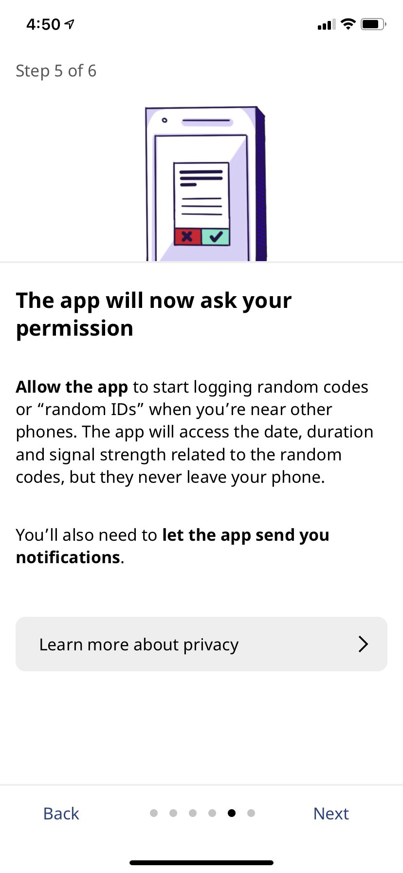
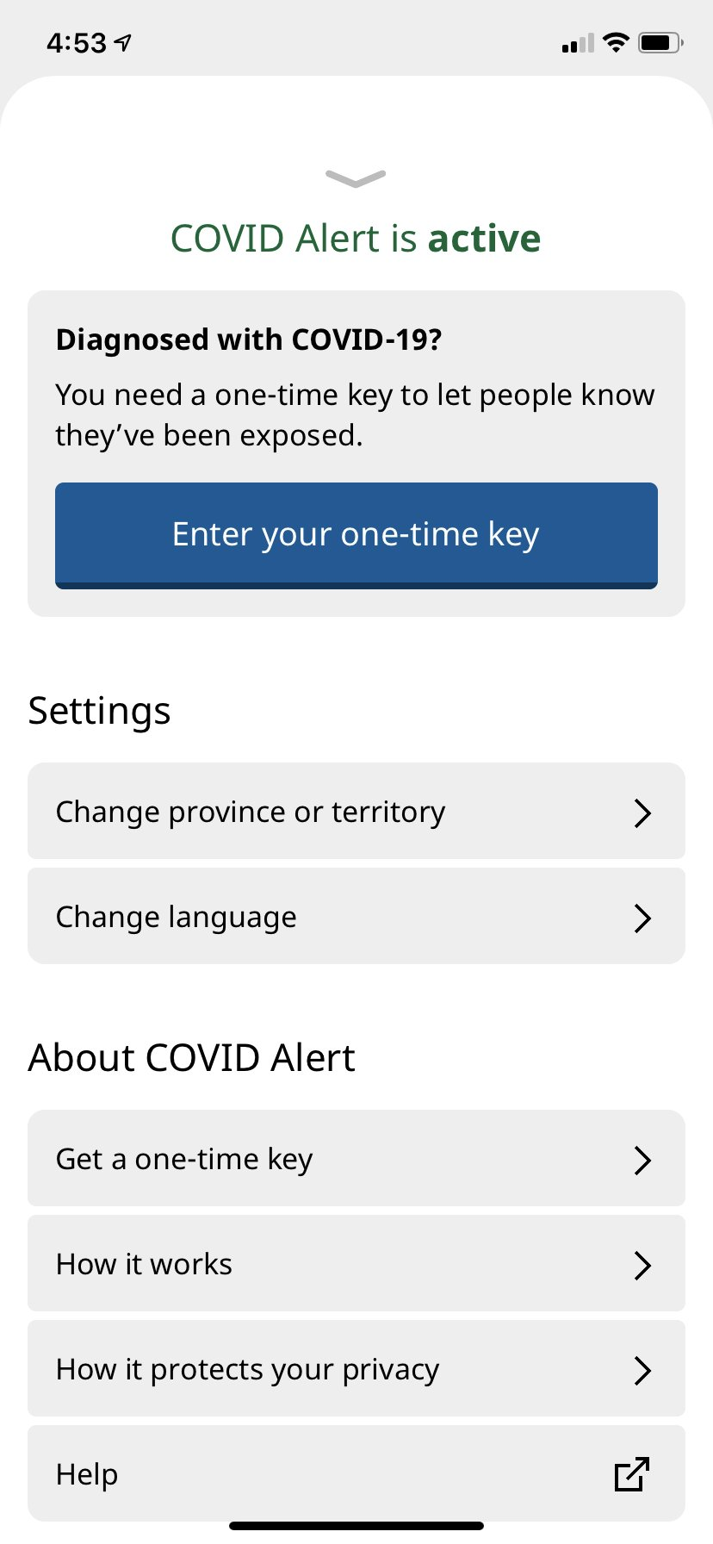
Running Example: Digital Contact Tracing
Two main features:
Contact Identification
people who have been exposed are identified
Contact Notification
people are notified of their potential exposure
Notes:
As a running example, we’ll be using Digital Contact Tracing.
You may have heard about contact tracing through the news, and you read about it as part of the prep activity.
As a brief reminder, the two core features of digital contact tracing are contact identification and notification.

Slide 19
Preliminary design choices
Is contact tracing always “on,” or is it just used at certain establishments (e.g., restaurants)?
Does the app use phone-to-phone communication, or do we add additional hardware beacons?
Do we use bluetooth or GPS or neither?
How is the app distributed?
…
Notes:
There are hundreds of ways to build digital contact tracing.
Here are some example design choices we have to make in designing a contact tracing app.
Where does it work? Are we making an app which is designed to be “always on”, and collecting data anywhere we bring our phone? Or do we want something more focused - perhaps an app which we need to use only in certain higher-risk interactions, like dining at a restaurant?
How does the app work? Is it a phone-to-phone contact tracing app? Or is there some additional hardware we need? If you’re around MIT at the moment, you probably know that MIT’s contact tracing solution is not using smartphones at all: instead, they’re using RFD tags and tracking stations in high-contact spaces, like dorm kitchens.
Do we use bluetooth or GPS?
How is the app distributed?
These are just a few questions you’d have to answer.

Slide 20
Ethics Protocol Overview
Envision Possible Futures
Notes:
So, let’s jump in to envisioning possible futures for our contact tracing apps.
As a reminder, this was your preparatory assignment.

Slide 21
Contact Tracing Imagined Futures
The government releases a contact tracing app. Within two months, there were zero COVID-19 cases in the country. Hundreds of thousands of lives were saved. Schools reopened, businesses flourished, and the roaring twenties kicked off. The government preemptively decided to stop collecting data from users, but maintained the app for in case of future pandemics.
Notes:
Here’s one possible future I wrote. This is, I suppose, a “Light Mirror” episode.

Slide 22
Contact Tracing Imagined Futures
< Room X: Add your imagined futures>
Notes:
Now, it’s your turn. I’m going to break us all into rooms, and I want you as a room to discuss your envisaged futures. Each room has a slide, like this one shown above.
I’ll share access to these slides so you can add your envisaged futures.
After 5 minutes, we’ll come back together and discuss as a larger group.

Slide 23
Contact Tracing Imagined Futures
5 minutes

Slide 24
Contact Tracing Imagined Futures
POSITIVE
Faster pandemic recovery
NEUTRAL
What happens to data after contact tracing is know longer needed?
Increased Legislation for reusing the app
Data used for future research
NEGATIVE
Track certain groups movements through the app (e.g. criminals)
Overreach for other examples that don’t require...
Make assumptions about movement of certain groups

Slide 25
Contact Tracing Imagined Futures
Surveillance state
Disproportionately harms marginalized communities
Protestors/whistleblowers at risk (one person traced can lead to tracking others)
Buggy App
Loses User’s Trust, causes mass panic, doesn’t prevent spread
App is hacked/compromised
Can be used for ransom/stalking/blackmail

Slide 26
Contact Tracing Imagined Futures
Privacy issues: creators of the app have access to other users’ locations and may use users’ information for financial gain (e.g. selling to companies), could be used in turn for individual marketing
Overconfidence issue: users’ behavior becomes more risky as they underestimate exposure and reduce testing frequency
Government abuse: using the app to track groups of people / how they interact, potentially voter suppression

Slide 27
Contact Tracing Imagined Futures
< Room 4: Add your imagined futures>
Good:
Limited only for pandemic
Bad:
Using for other domains
Collected data unintentionally leaks sensitive information or is misused/sold

Slide 28
Contact Tracing Imagined Futures
Social media could be transformed if this contact tracing app takes off. Something like proximity-based socialization and connecting to others.
Surveillance from government and corporations increases. What if our location data is all sold?

Slide 29
Ethics Protocol Overview
Identify
Stakeholders
Envision Possible Futures
Notes:
The next step is to identify stakeholders.

Slide 30
What is a stakeholder?
Notes:
But first we need to define stakeholder!

Slide 31
What is a stakeholder?
A stakeholder is anyone or any thing that can affect or be affected by your project.
Notes:
We define a stakeholder as anyone or any thing that can affect or be affected by your project.

Slide 32
Stakeholders are not (just):
You & your institution
Financial backers (shareholders)
Users

Slide 33
Why define stakeholder so broadly?

Slide 34
Why define stakeholder so broadly?
There are no ethical externalities.
Notes:
We cannot box an entity and say, “you’re not our priority so you won’t experience ethical implications.”
There are no ethical externalities.

Slide 35
That doesn’t mean you’re responsible for everything.

Slide 36
But, to make things ethically, you need to know what all the ethical elements are!

Slide 37
Stakeholder subgroups matter.
Notes:
And as a particular note, stakeholder subgroups are important.

Slide 38
Contact Tracing Stakeholders
Smartphone users
Not-smartphone users
Notes:
Two example stakeholders for contact tracing are smartphone users and not-smartphone users.

Slide 39
Contact Tracing Stakeholders
Smartphone users
Not-smartphone users
Black people
Hispanic or Latino people
Notes:
For COVID-19, some important subgroups to consider are Black, Hispanic, and Latino people.
We know these communities are disproportionately affected by this pandemic, and we need to make sure we think about how contact tracing will further impact them.

Slide 40
Contact Tracing Stakeholders
Task: Brainstorm as many stakeholders as you can
5 minutes

Slide 41
Contact Tracing Stakeholders
Coronavirus(?)
Low income communities
Developers
Governments
Different Age Groups
People in areas with worse connectivity
People who are benefiting from the pandemic.

Slide 42
Contact Tracing Stakeholders
< Room 2: Add your stakeholders>
Healthcare workers
Essential workers
Businesses/potential hubs for transmission
Maker of app

Slide 43
Contact Tracing Stakeholders
Homeless & low-income
Healthcare workers
BIPOC
Non-smartphone owners
Elderly
Disabled
Children
Essential workers
Public transportation users
Government (all levels)

Slide 44
Contact Tracing Stakeholders
Users
Non-Users: Elderly (non-smartphone users)
Government
Hospitals
Testing Centers
Academia
Big pharma
Inter-Country Tracing Systems

Slide 45
Contact Tracing Stakeholders
< Room 5: Add your stakeholders>
Lower-income, anyone without a phone or areas with poor connectivity
Rural vs. urban?
Proximity to other people (tracing you through other people’s devices)
Older vs younger
People
Tech
New tech - less hackable but built in hardware
BIPOC

Slide 46
Ethics Protocol Overview
Identify
Stakeholders
Envision Possible Futures
Identify
Values at Play
Notes:
The next step is to identify values at play

Slide 47
Moral Lenses
Different ways of looking at effects on stakeholders that reveal different kinds of ethical significance.
Notes:
Moral lenses are a sub-tool of the ethics protocol. We use these to identify values at play.
Moral lenses are different views we can take for analyzing the ethical consequences of a decision.
Let’s look at a few lenses.

Slide 48
Outcome Lens
In what ways does what you’re making turn out better or worse for your stakeholders?
Notes:
The first lens views the outcomes or consequences of a decision.
In what ways did your decision turn out better or worse for your stakeholders?
Note there is no precise definition of best or worst. This analysis may not be entirely straightforward.
For COVID, for example, one definition of “best” might be that life looks the most normal for the most stakeholders. Another definition of “best” might be that the fewest of these stakeholders get sick.

Slide 49
Process Lens
How did the process treat stakeholders?
Think: autonomy, consent, transparency, participation, etc.
Notes:
The second lens is the process lens.
How did we treat stakeholders throughout the design process and in our final decision?
Did we trick them? Did we include them? Do they understand our solution?

Slide 50
Structure Lens
How are the outcomes distributed among different stakeholders? What are the differences in how different stakeholders were treated by the process?
Could be called ‘Justice Lens’
Notes:
The third lens I’ll introduce is the structure lens. Another name for this could be the “Justice Lens”
The structure lens asks you to explicitly think about subgroups of stakeholders.
How were the outcomes distributed among different stakeholders? What are the differences in how they were treated by the process?

Slide 51
Outcome, Process, Structure
What’s missing?
What are your values?
Notes:
We introduced three lenses: outcome, process, and structure.
These lenses might seem a little pie-in-the-sky, but we find them to be useful for analyzing specific decisions.
We’ll jump into some concrete examples in just a moment.
But first, I want to stress that these lenses may not have coverage of the ethical dimensions you care about.
What are your values? Are they not represented?
You can add your own lenses to help support your decision-making.

Slide 52
Ethics Protocol Overview
Identify
Stakeholders
Identify
Value-Laden Design Choices
Envision Possible Futures
Identify
Values at Play
Notes:
The next step is to identify value-laden design choices

Slide 53
Two ways to identify value-laden design choices
Notes:
There are two ways to identify value-laden decisions.

Slide 54
Two ways to identify value-laden design choices
Work forward: Take a choice you know you’d have to make and trace out the value-laden implications
Notes:
The first is to work forward.
Take a design choice you’ll have to make, and use the moral lenses to assess the value-laden implications.

Slide 55
Preliminary design choices
How are COVID-19 cases identified?
Notes:
For example, one choice we have to make for digital contact tracing is to answer: how are COVID-19 cases identified?

Slide 56
Possible Choice | Values promoted (and for whom?) | Values demoted (and for whom?)
Option A
Option B
Option C
Notes:
I can think of three possible options here.
The first is that users post their COVID-19 status without proof.
The second is that users post their COVID-19 status with an accompanying doctor’s note.
The third is that we use experimental MIT technology to identify COVID-19 from vocal patterns.
Of course, there are more choices, but let’s limit ourselves to these three right now.
Outcome Lens: In what ways did your decision turn out better or worse for your stakeholders?
Process Lens: How did we treat stakeholders throughout the design process and in our final decision?
Did we trick them? Did we include them? Do they understand our solution?
Structure Les: think about subgroups of stakeholders.
How were the outcomes distributed among different stakeholders? What are the differences in how they were treated by the process?

Slide 57
Possible Choice | Values promoted (and for whom?) | Values demoted (and for whom?)
Users post their COVID-19 status without proof
Option B
Option C
Notes:
I can think of three possible options here.
The first is that users post their COVID-19 status without proof.

Slide 58
Possible Choice | Values promoted (and for whom?) | Values demoted (and for whom?)
Users post their COVID-19 status without proof
Users post their COVID-19 status with doctor’s note
Option C
Notes:
The second is that users post their status with a doctor’s note

Slide 59
Possible Choice | Values promoted (and for whom?) | Values demoted (and for whom?)
Users post their COVID-19 status without proof
Users post their COVID-19 status with doctor’s note
We identify COVID-19 status by monitoring vocal patterns [src]
Notes:
The third is that we use experimental MIT research to identify positive cases through analyzing vocal patterns

Slide 60
Possible Choice | Values promoted (and for whom?) | Values demoted (and for whom?)
Users post their COVID-19 status without proof | Structure Lens: users don’t have to see a doctor Process Lens: the process is entirely transparent | Outcome Lens: bad actors can prank the system
Users post their COVID-19 status with doctor’s note
We identify COVID-19 status by monitoring vocal patterns [src]
Notes:
Of course, there are more choices, but let’s limit ourselves to these three right now.
Having identified these three options, we can start to assess: what values are promoted? What values are demoted?
For example, if we let users post their status without proof,
The structure lens shows us that users benefit since they don’t have to see a doctor (which has a high barrier to access)
The process lens shows us that the users benefit from the transparency, since they have to understand their positive status in order to share it.
The outcomes lens shows us that some users are hurt, as it’s possible for anyone to easily prank the system.

Slide 61
Possible Choice | Values promoted (and for whom?) | Values demoted (and for whom?)
Users post their COVID-19 status without proof | Structure Lens: users don’t have to see a doctor Process Lens: the process is entirely transparent | Outcome Lens: bad actors can prank the system
Users post their COVID-19 status with doctor’s note | Outcome Lens: the least false positives | Structure Lens: high barrier to use Process Lens: compromises privacy
We identify COVID-19 status by monitoring vocal patterns [src] | Outcome Lens: we’re able to identify the most cases using this technology | Process Lens: users didn’t consent to this data collection Structure Lens: the model only uses English data.
Notes:
Outcome Lens: In what ways did your decision turn out better or worse for your stakeholders?
Process Lens: How did we treat stakeholders throughout the design process and in our final decision?
Did we trick them? Did we include them? Do they understand our solution?
Structure Les: think about subgroups of stakeholders.
How were the outcomes distributed among different stakeholders? What are the differences in how they were treated by the process?

Slide 62
Two ways to identify value-laden design choices
Work forward: Take a choice you know you’d have to make and trace out the value-laden implications
Work backward: You’ve identified futures and their ethical dimensions. Which choices result in which outcomes?

Slide 63
Working backward
One envisioned future is that there are so many false positives, the system is incredibly ineffective and we give up using it.
One contributing design decision could be this question of how positive cases are communicated.
Notes:
As an example of how we can work backward, let’s imagine this future: there are so many false positives, the system is ineffective and we give up using it.
What value-laden design decisions may have contributed to this?
One example may be this question of How COVID-19 cases are identified?

Slide 64
Preliminary design choices
How are COVID-19 cases identified?
GPS vs Phone-to-Phone Bluetooth
Opt-in vs opt-out?
Distribution mechanism?
Always on, or only used in certain locations?
…
Notes:
OK, I’m about to break us into rooms to try applying this process. You can either “work forward” or “work backward”. If you work backward, you can use the envisaged futures from your assignment and earlier discussions. If you work forward, here are some design choices you could think about. But there are many more!
Does your app use GPS or Phone-to-Phone Bluetooth?
Is the system opt-in or opt-out?
How is your app distributed?
Is your app always on, or only used in certain locations?

Slide 65
Possible Choice | Values promoted (and for whom?) | Values demoted (and for whom?)
GPS | Outcomes: we can remove outdoors Justice: works anywhere in the world | Outcomes: generally worse protocol Process: collecting a lot more data
Bluetooth | Outcomes: we’re more confident you were in close proximity
Option C
Room 1
Notes:
Outcome Lens: In what ways did your decision turn out better or worse for your stakeholders?
Process Lens: How did we treat stakeholders throughout the design process and in our final decision?
Did we trick them? Did we include them? Do they understand our solution?
Structure Les: think about subgroups of stakeholders.
How were the outcomes distributed among different stakeholders? What are the differences in how they were treated by the process?

Slide 66
Possible Choice | Values promoted (and for whom?) | Values demoted (and for whom?)
Option A
Option B
Option C
Room 2
Notes:
Outcome Lens: In what ways did your decision turn out better or worse for your stakeholders?
Process Lens: How did we treat stakeholders throughout the design process and in our final decision?
Did we trick them? Did we include them? Do they understand our solution?
Structure Les: think about subgroups of stakeholders.
How were the outcomes distributed among different stakeholders? What are the differences in how they were treated by the process?

Slide 67
Ethics Protocol Overview
Identify
Stakeholders
Identify
Value-Laden Design Choices
Envision Possible Futures
Identify
Values at Play
Choose & Justify

Slide 68
How are COVID-19 cases identified?
Choice: Users post their COVID-19 Status by acquiring an authorization code from their doctor.
This prevents bad actors from manipulating the system, forcing unnecessary self-isolation, unlike without requiring authorization codes.
Users consent, unlike with the voice monitoring solution.
Fewer users report, since this requires the financial means/feelings of security needed to see a doctor in the US.
Privacy is compromised since users can be associated with a specific doctor’s visit.
Notes:
Make slides for each breakout group

Slide 69
Contact Tracing Choose & Justify
5 minutes

Slide 70
Question?
Choice
Justification
Room 1
Notes:
Make slides for each breakout group

Slide 71
Ethics Protocol Overview
Identify
Stakeholders
Identify
Value-Laden Design Choices
Build
Envision Possible Futures
Identify
Values at Play
Choose & Justify
Notes:
OK, finally I want to talk about that last piece: building your software.
You’ll notice that in the overview, we draw an arrow to and from “Choose and Justify”.

Slide 72
“Minor” technical decisions can have ethical consequences.
Build
Choose & Justify
Notes:
One of the reasons that we can’t just use the ethics protocol once at the beginning of a project and be done with it is that “minor” technical decisions can have ethical consequences.
It has to be an iterative process.

Slide 73
Immediate Notifications?
Build
Choose & Justify
Notes:
Assume we’re designing a phone-to-phone bluetooth contact tracing app.
Each phone you come in “contact” with shares a one-time key identifying it. You know that specific key, and the phone that shared it knows every one-time key they’ve ever shared.
One downstream technical question we have to answer is: do we want immediate notifications?
If we’re OK with notifications not being immediate, we can store the set of one-time keys we’ve received locally (which is better for privacy). To check whether we’ve been exposed to COVID-19, we regularly poll a for all one-time keys which identify covid-positive phones. (Extra cost: regular polling)
If we want notifications to be immediate, we can instead send all our received keys to the server (Google/Apple?). As soon as a key is reported as COVID-positive, the server can notify us. This comes with the cost of sharing all our one-time keys. Even though these one-time keys are anonymous, they can potentially be combined with other data (for example, time of upload, your doctor’s note & covid transmission rates in your community) to compromise privacy.

Slide 74
Don’t forget to ask:
“Should I build this?”
Fin!
Reminder: You’ll use the ethics protocol in your final projects.
Notes:
The ethics protocol is most useful for helping you consider the ethical implications of your work, and for finding ways to compromise and uphold your principles as you do so.
Don’t forget, though, to ask “Should I build this?” Sometimes the answer is simply no.

Slide 75
Learn More Ethics!
Classes (Spring `21):
24.191 Being, Thinking, Doing (or not): Ethics in Your Life
24.03 Good Food: The Ethics and Politics of Food
24.231 Ethics: Systematic study of central theories in ethics
24.237(J) Feminist Thought
Other:
PKG Center - internships, colloquia, funding for your ideas, lots of opportunities!
AI Ethics Reading Group, AI Alignment Reading Group, & more

Slide 76
Q&A

Slide 77
MIT OpenCourseWare
https://ocw.mit.edu
RES.TLL-008 Social and Ethical Responsibilities of Computing (SERC)
Fall 2021
For information about citing these materials or our Terms of Use, visit: https://ocw.mit.edu/terms

